Slide 1
Heat Loss in Accelerating Rate Calorimetry (ARC) Analysis and Thermal Lag for High Self-Heat Rates
Min Sheng
Reactive Chemicals Technical Leader at Corteva AgriScience

Slide 2
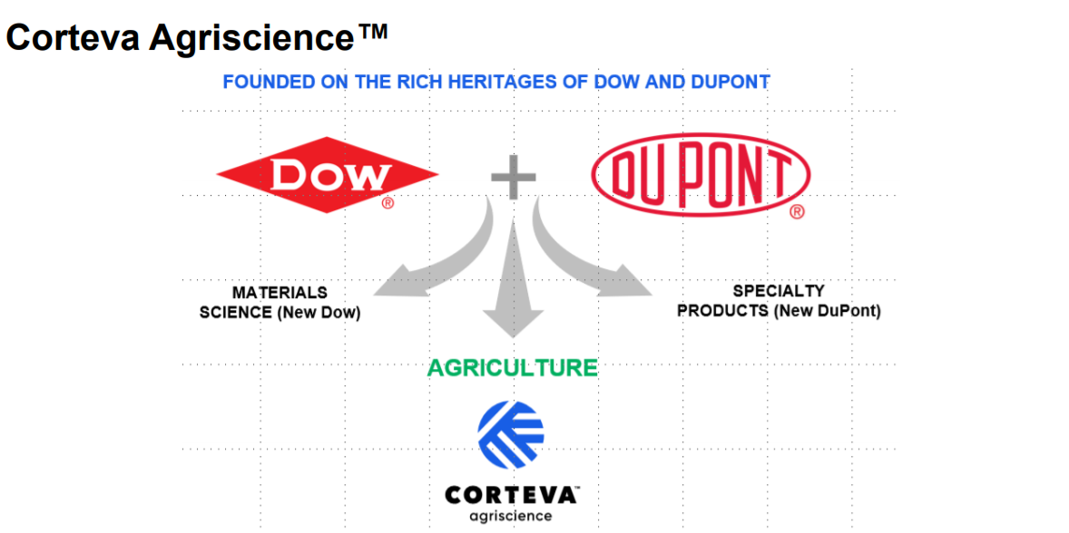


Slide 3

Min Sheng, Ph.D., P.E.
Education:
  M.S. and B.S., ChE, Tianjin Univ., China
  Ph.D., ChE, Auburn Univ., Auburn, AL
Work Experience
  2/2012 to 8/2017, Dow, Reactive Chemicals (RC) Subject Matter Expert
  9/2017 to present, Corteva (DowDuPont Ag division), RC Technical Leader
Competencies and Skills
  Expertise Including Calorimetry, kinetic modeling, high energy materials and flammability
  Licensed Professional Engineer in Michigan state
  ASTM E27 (Hazard Potential of Chemicals) committee member
  ACS Chemical Health and Safety Journal, Editorial Advisory Board member

Slide 4
Accelerating Rate Calorimetry (ARC)
Outline:
Heat loss from ARC bomb
Thermal lag at high self-heat rate
More information: Min Sheng, Daniel Valco and Craig Tucker, Heat Loss in Accelerating Rate Calorimetry Analysis and Thermal Lag for High Self-Heat Rates, Org. Process Res. Dev. 2021, 25, 1, 108-119 (https://pubs.acs.org/doi/abs/10.1021/acs.oprd.0c00459)

Slide 5
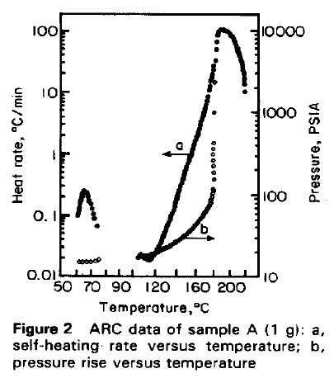
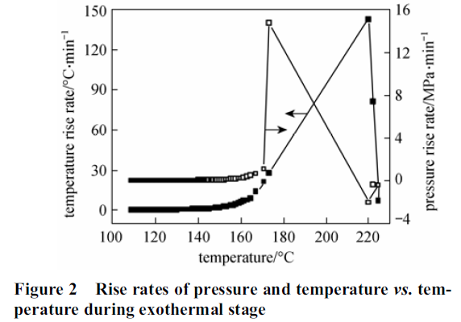
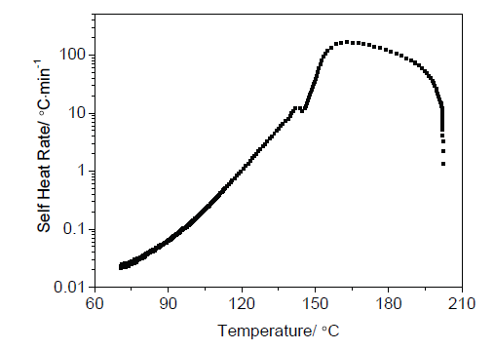
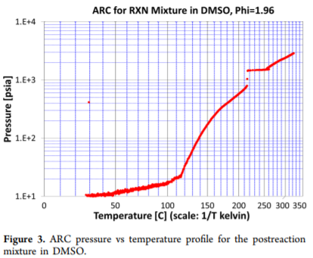
Why do I care?
Total heat measured by ARC is always different from values measured by others (e.g. DSC). How much difference is considered as “reasonably agree”?
We all know that ARC will loss adiabatic at high self heat rates. But what this means to you?
Is something wrong in those ARC tests?
Slope changed above 160C
P rate beats heat rate T scales (time)
P “step up” @ 217C
Chin. J. Chem. Eng., Vol. 20, No. 4, August 2012
Procedia Engineering 45 ( 2012 ) 574 – 579
Org. Process Res. Dev. 2018, 22, 10, 1441–1447
Thermal decomposition of 3-amino-5-methyl isoxazole, Short Communications

Slide 6
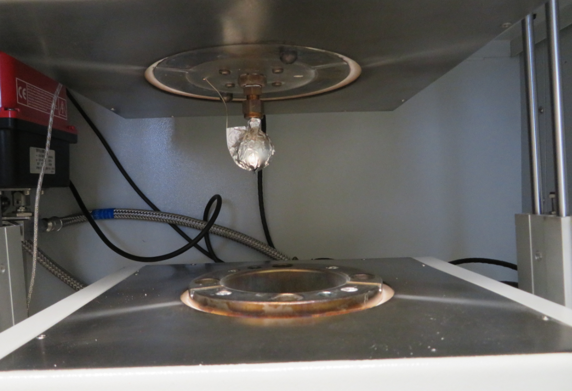
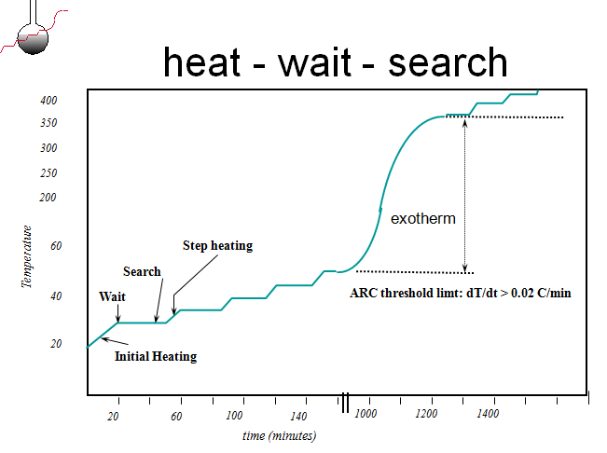
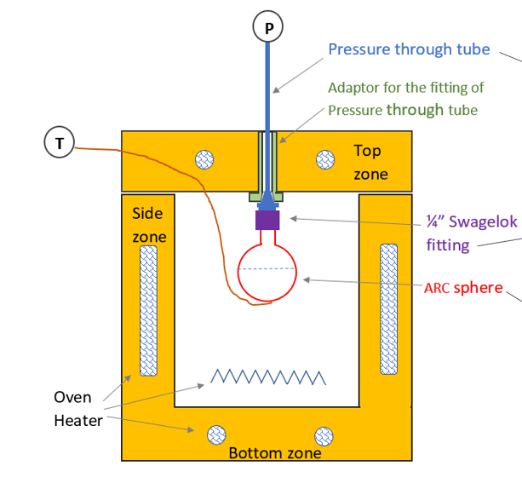
ARC Calorimetry
Detect an exo and then maintain an adiabatic condition
Ideally, oven T always the same as sample T

Slide 7
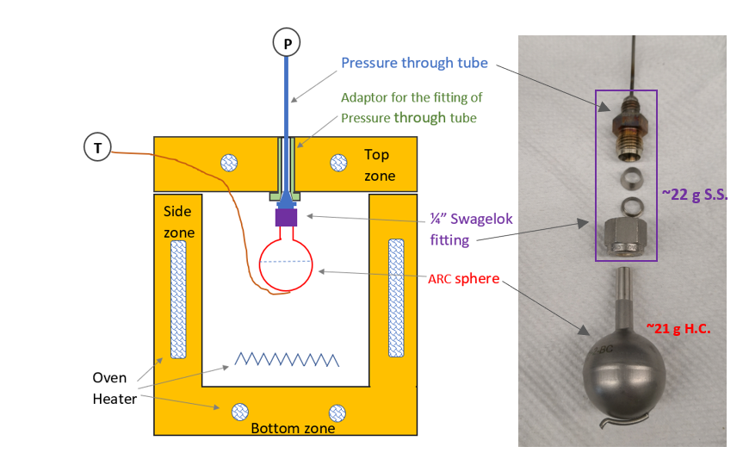
Heat balance of ARC bomb w. sample
1. Accumulation
2. Convective to oven
3. Conduction through fitting
4. Generation from sample
Assumption: term 2 and 3 are zero
Heat losses will lower the measured heat
Term 2: convective heat loss for non-adiabatic condition
Term 3: unknown conduction heat loss (~22g Fitting, no embedded heater, only heat source is conduction from ARC lid)
ARC measured this

Slide 8
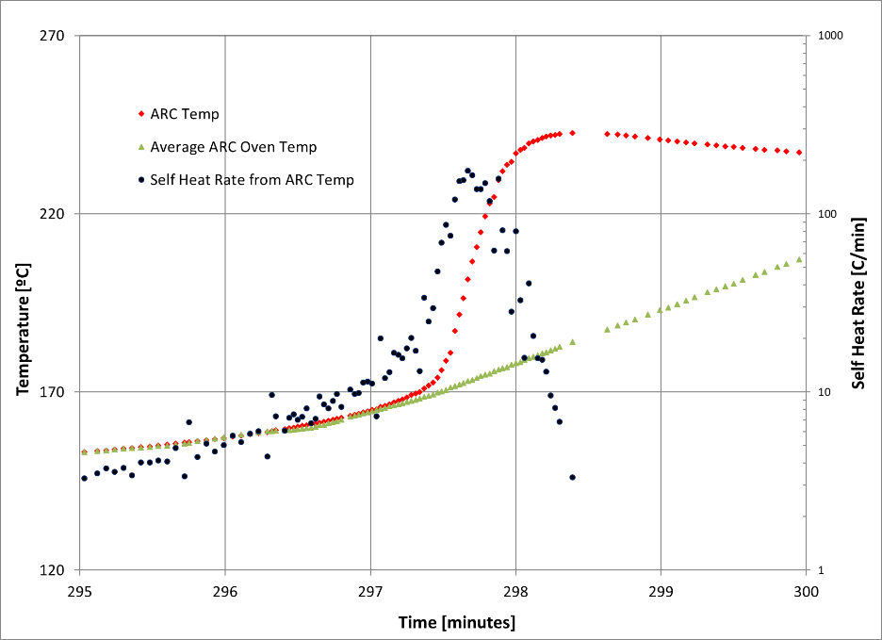
Non-adiabatic conditions of ARC
Original Dow ARC could maintain adiabatic condition up to 20℃/min.
Corteva THT ARC
  ARC test for 50% DTBP in toluene; 4.03g in 21.114 g Hastelloy C ARC bomb
  Slope of oven T in 297.5~300min: 15.0 ℃/min (hardware limit)
DTBP: di-tert-butyl-peroxide

Slide 9
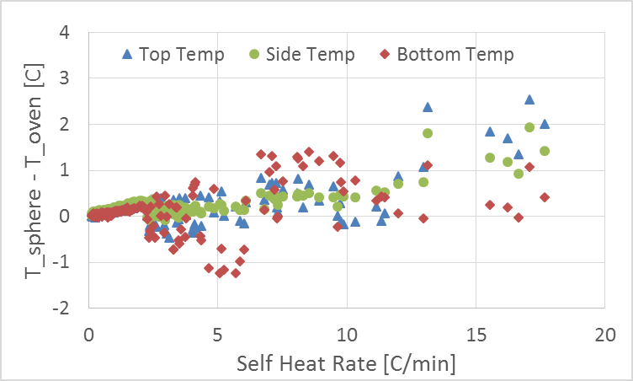
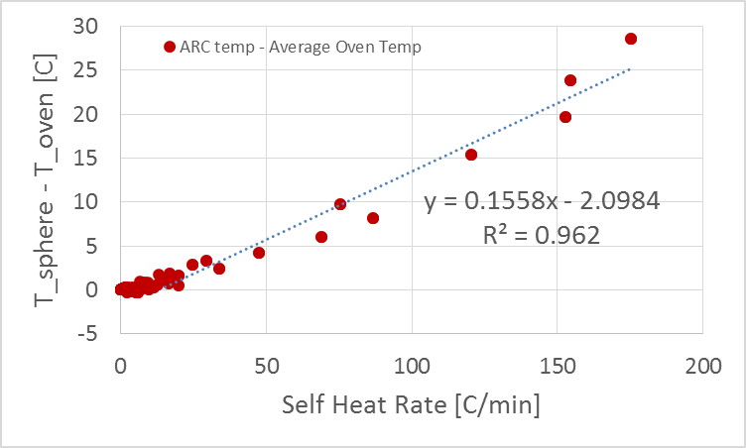
Non-adiabatic conditions of ARC
Difference between sample and oven
ΔT < 1 C below ~13 ℃/min ΔT = 0 °C at 13.5 ℃/min
We believe delay from control system lower such limit

Slide 10

Non-adiabatic conditions of ARC
Convective heat loss for non-adiabatic condition
For 100 ℃/min SHR, ΔT=13.5 ℃ ➔ 1.1 ℃/min (Only 1.1%)
UA=0.291W from Water cooling tests
With ΔT and UA ➔ 13.9J/g (~3% of total Heat, 473J/g)
Insignificant errors from heat loss to oven at non-adiabatic condition

Slide 11

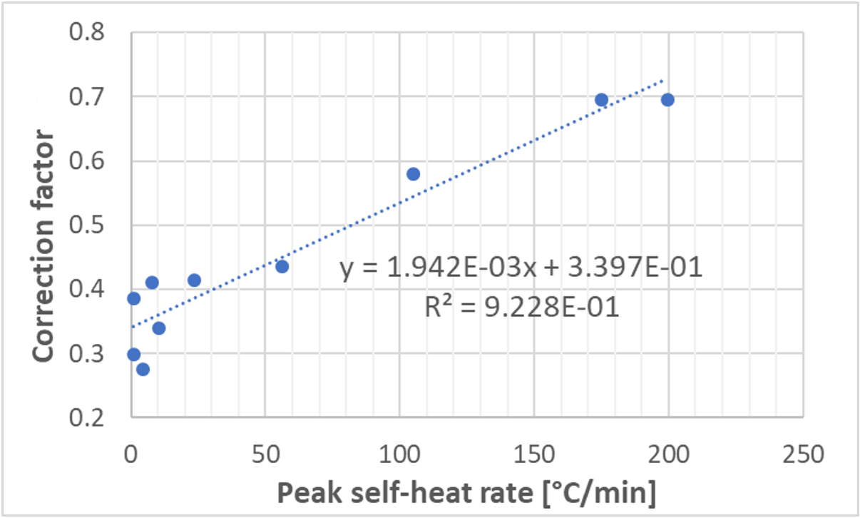

Heat balance of ARC bomb w. sample
Conductive Heat Loss to the fitting: Significant
errors
Simple correction:
 | ARC (J/g) | DSC (J/g) | Low by | ARC run note | β
20% DTBP (standard) | -260 ± 21 | -307.7±16.1 | 16% | Adiabatic (max SHR 6~10C/min) | 0.41
1.295g 50% DTBP | -560 | 710.7 | 21% | Adiabatic (max SHR 4.51C/min) | 0.28
4.030g 50% DTBP | -473 | 710.7 | 33% | Non-Adiabatic (max SHR 224C/min) | 0.70
T_{f} is always lower during an EXO:
1. A lot of fitting mass (~22g)
2. Only conduction heat from ARC lid
3. Sample T is higher than ARC T (page 13)
How much difference is considered as “reasonable agree”? Typically lower by ~20%.
bomb
fitting

Slide 12
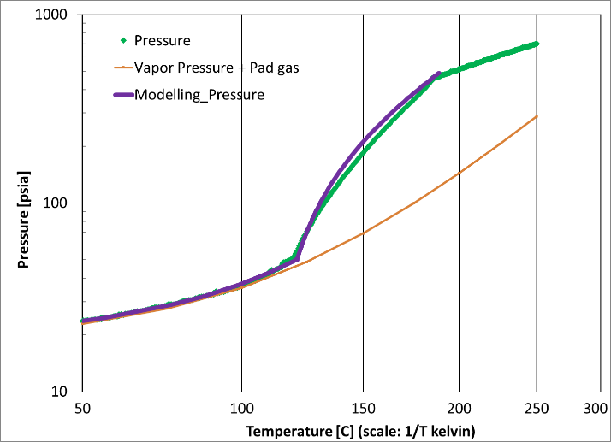
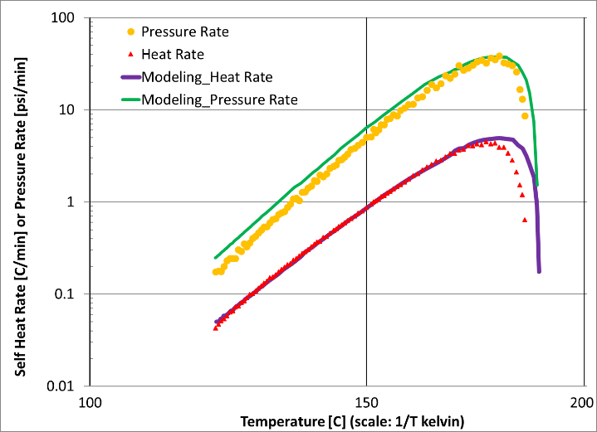
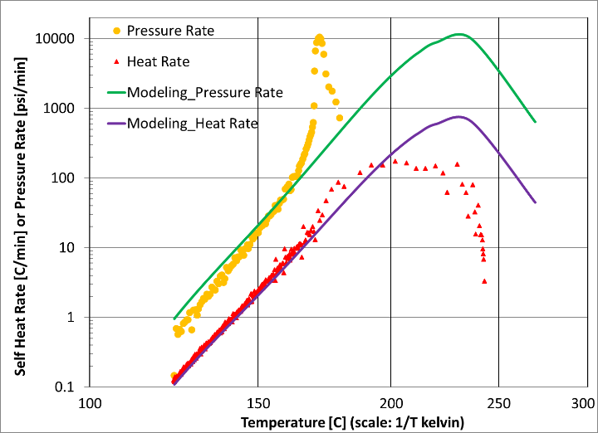
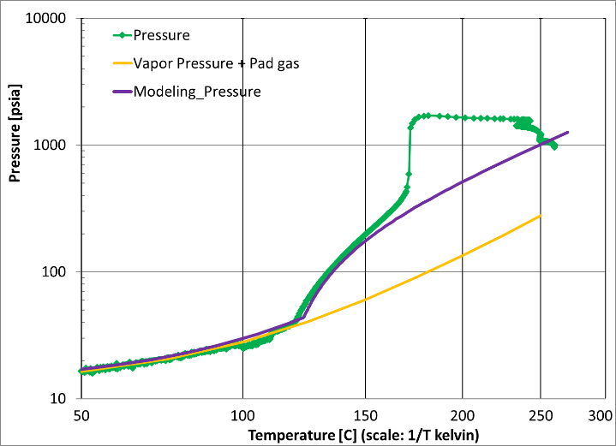
Thermal lag issue at high self-heat rate
50% DTBP in toluene
1.295g
Fit a kinetic model by TSS
4.030g
Model prediction from previous ARC

Slide 13
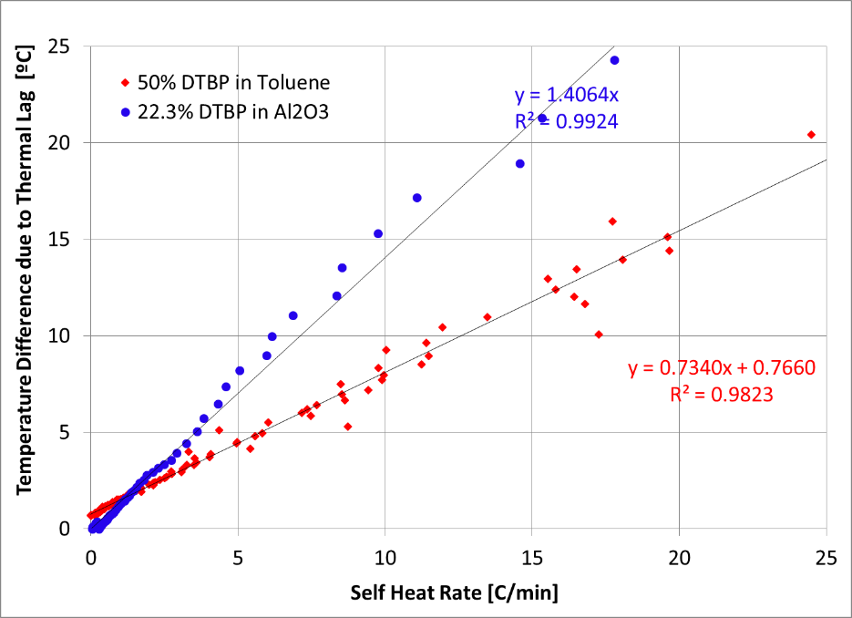
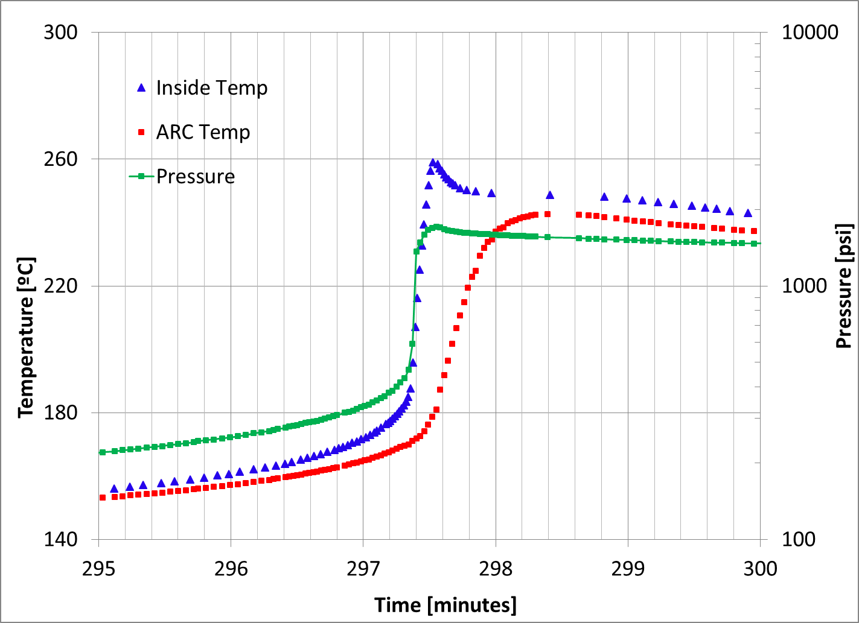
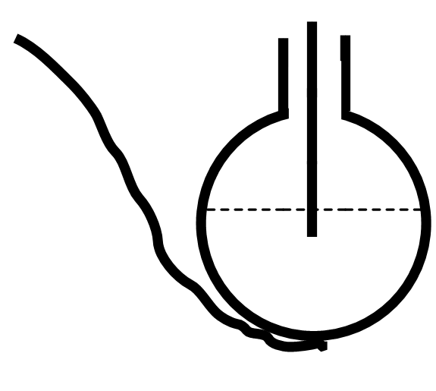
Thermal lag issue at high self-heat rate
4.030g 50% DTBP in toluene
Thermal lag caused by the thermal resistance of point contact between ARC sphere and the ARC thermocouple: ΔT is proportional to heat rate
Even under adiabatic condition (HR<13.5C/min), actual sample T (bomb) will still higher than ARC measured T, so higher than oven Temperature ➔ conduction heat loss?

Slide 14
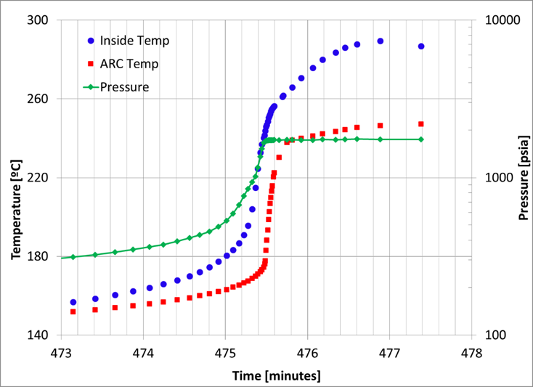
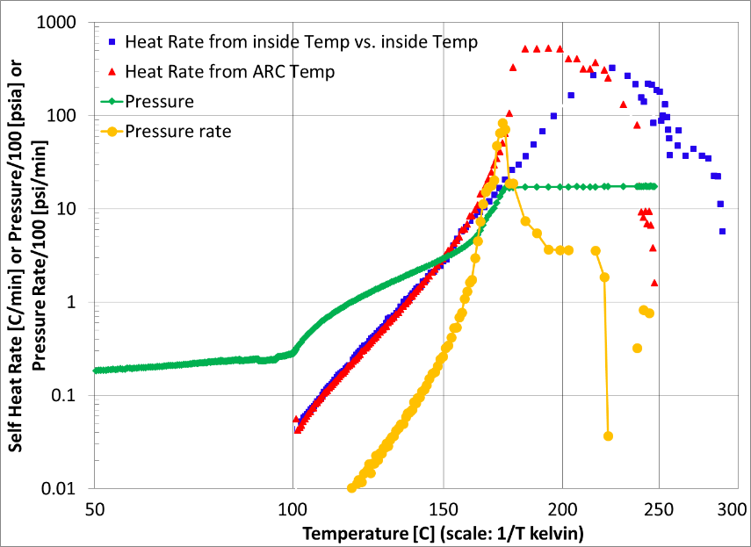
Thermal lag issue at high self-heat rate
9.679g 22.3% DTBP in Alumina
Additional thermal lag caused by the thermal resistance through solid sample
Based on ΔT slope, thermal resistance: 52% from bomb-thermocouple and 48% from solid sample

Slide 15
If I care, so what?
Total heat measured by ARC is always different from values measured by others (e.g. DSC). How much difference is considered as “reasonable agree”? Typically lower by ~20%.
We all know that ARC will loss adiabatic at a high self heat rate. But what this means to you? Non-adiabatic has insignificant impact, but thermal lag has.
Is something wrong in those ARC tests? Thermal lag of ARC instrument
Slope changed above 10C/min
P rate beats heat rate T scales (time)
P “step up” @ 217C
Chin. J. Chem. Eng., Vol. 20, No. 4, August 2012
Procedia Engineering 45 ( 2012 ) 574 – 579
Org. Process Res. Dev. 2018, 22, 10, 1441–1447
Thermal decomposition of 3-amino-5-methyl isoxazole, Short Communications

Slide 16
Conclusions
Apologize for that we have not solved any of those problems. Just try to better understand them.
Heat balance of ARC bomb shows the errors from converstion heat loss to oven is insignificant, but that from conduction heat loss to fitting is significant. Due to conduction, total heat from ARC is lower than that from DSC by ~20%.
Thermal lag issue at high self-heat rate could introduce a big error to kinetic fitting based on ARC
Acknowledge: Daniel Valco, Craig Tucker and Corteva RC team
Thank you for your time! Happy to answer any question.

